Slide 1
Control Structures

Slide 2
Objectives
Learn how relational operators
Learn how the conditional operator works
Discover how to use a switch statement in a program

Slide 3
Control Structures
A computer can proceed:
In sequence
Selectively (branch): making a choice
Repetitively: looping
By calling a function
The two most common control structures are:
Selection
Repetition

Slide 4
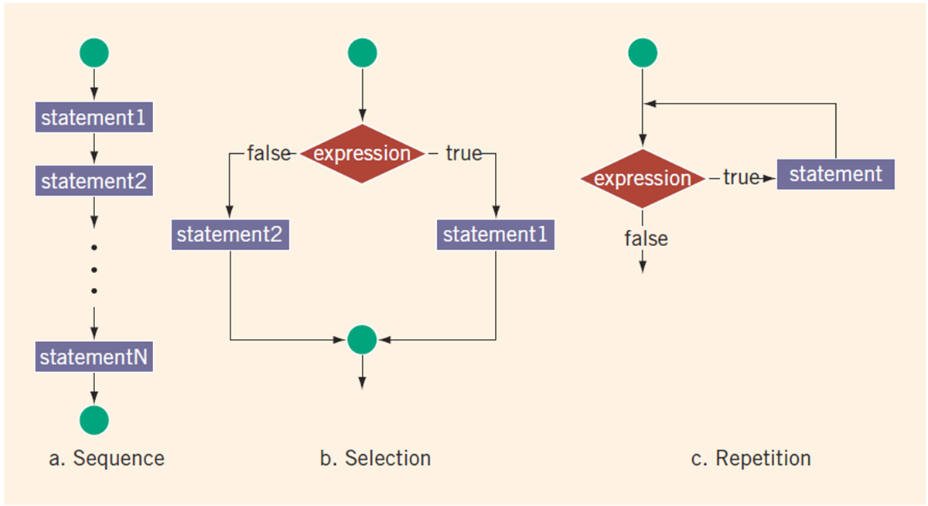
Control Structures

Slide 5
Selection: if and if...else
An expression that evaluates to true or false is called a logical expression
“8 is greater than 3” is true

Slide 6
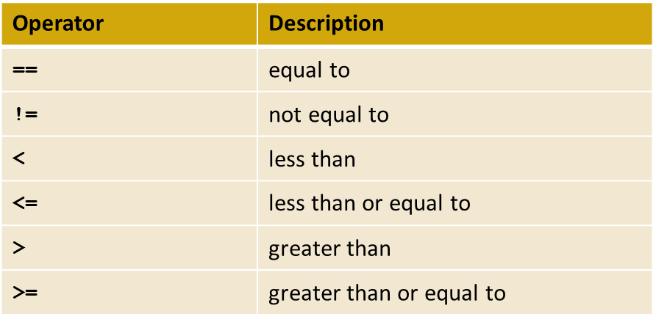
Relational Operators
Each relational operator is a binary operator (requires two operands)
Expressions using these operators always evaluate to true or false

Slide 7
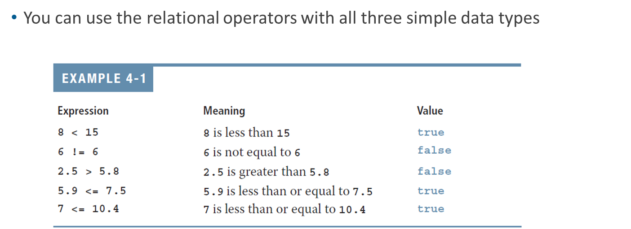
Relational Operators and Simple Data Types

Slide 8
Comparing Characters
In an expression of char values using relational operators:
The result depends on the machine’s collating sequence
ASCII character set
Logical (Boolean) expressions:
Include expressions such as 4 < 6 and 'R' > 'T’
Return an integer value of 1 if the logical expression evaluates to true
Return an integer value of 0 otherwise

Slide 9
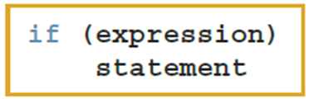
One-Way Selection (1 of 2)
One-way selection syntax
The statement is:
Executed if the value of the expression is true
Bypassed if the value is false; program goes to the next statement
The expression is also called a decision maker
The statement following the expression is also called the action statement

Slide 10
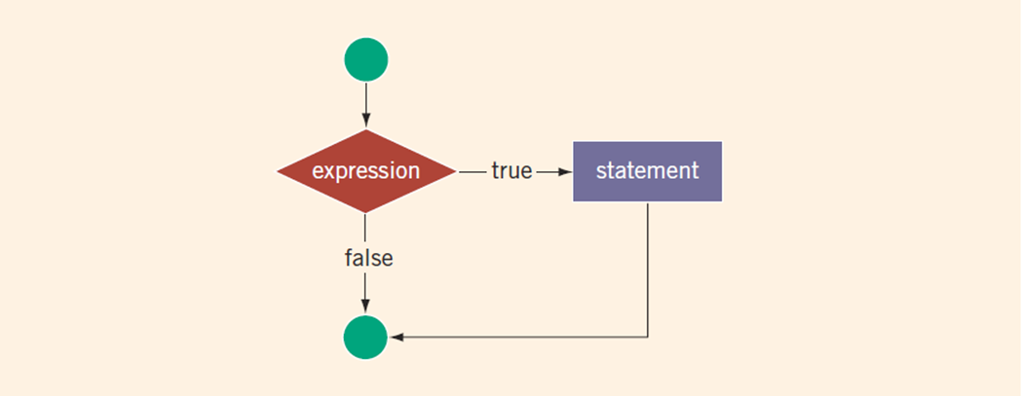
One-Way Selection (2 of 2)

Slide 11
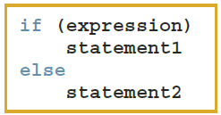
Two-Way Selection (1 of 2)
Two-way selection syntax
If expression is true, statement1 is executed; otherwise, statement2 is executed
statement1 and statement2 are any C++ statements

Slide 12
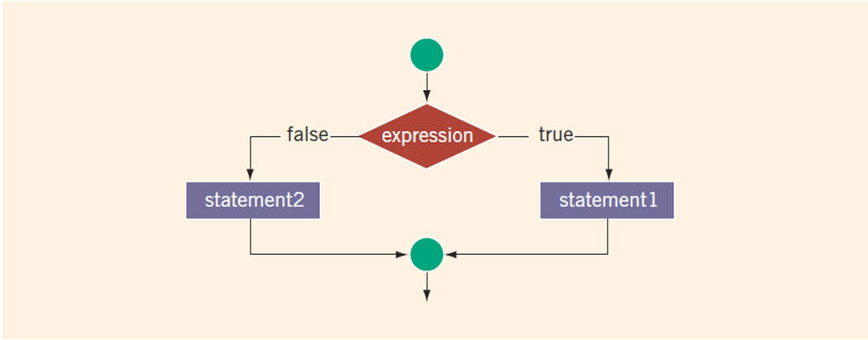
Two-Way Selection (2 of 2)

Slide 13
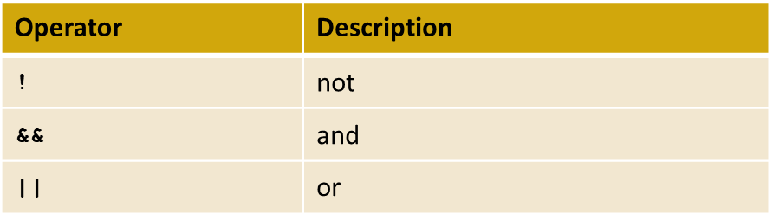
Logical (Boolean) Operators and Logical Expressions
Logical (Boolean) operators enable you to combine logical expressions

Slide 14
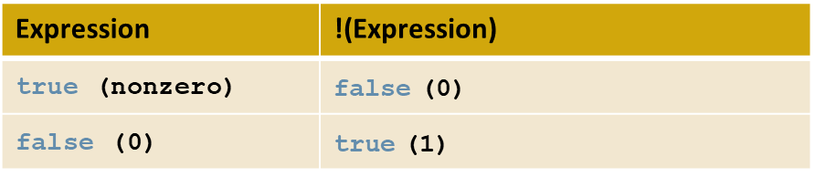
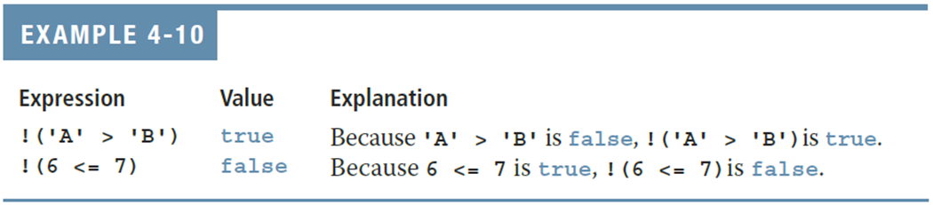
Logical (Boolean) Operators and Logical Expressions
TABLE 4-3 The ! (Not) Operator

Slide 15
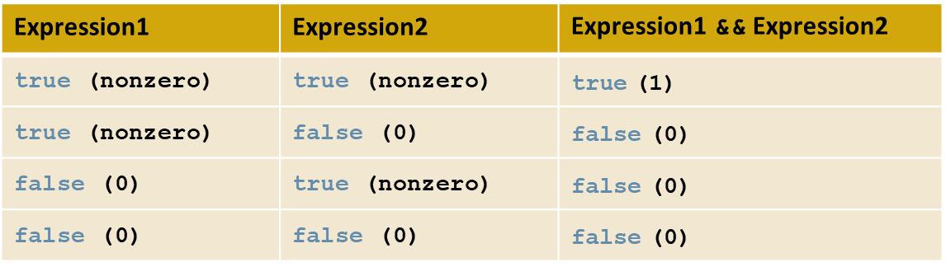
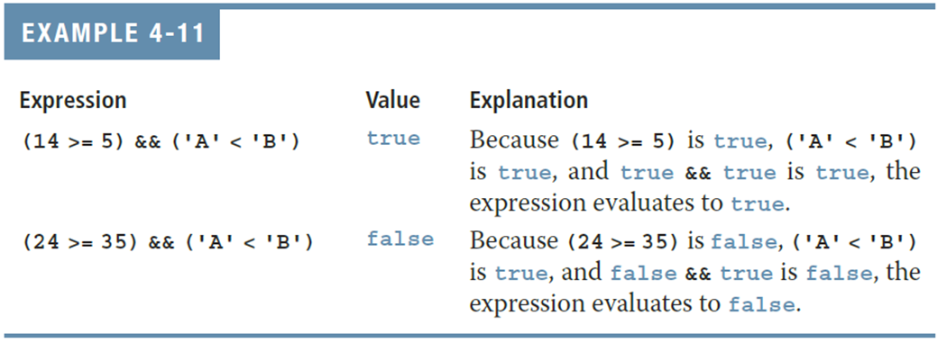
Logical (Boolean) Operators and Logical Expressions
TABLE 4-4 The && (And) Operator

Slide 16
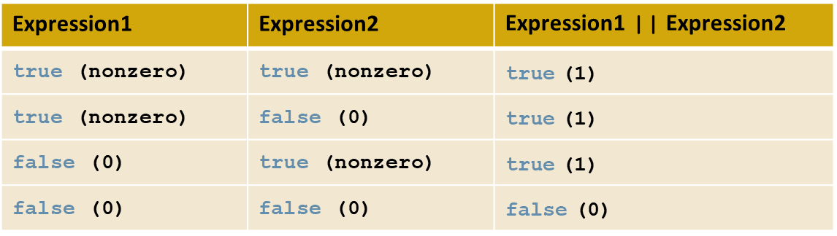
Logical (Boolean) Operators and Logical Expressions
TABLE 4-5 The || (Or) Operator

Slide 17
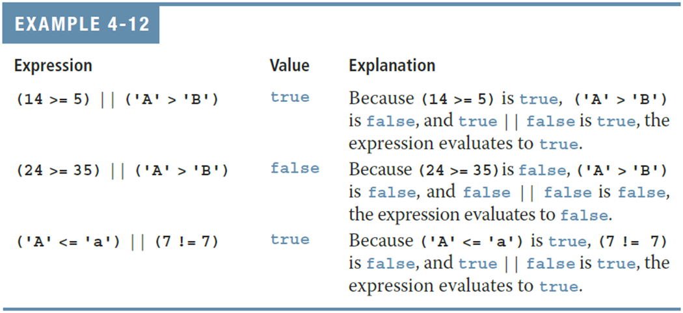
Logical (Boolean) Operators and Logical Expressions

Slide 18
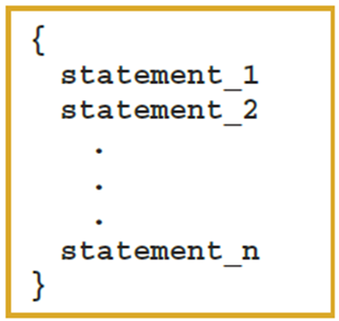
Compound (Block of) Statements
A compound statement (block of statements) has this form:
A compound statement functions like a single statement

Slide 19
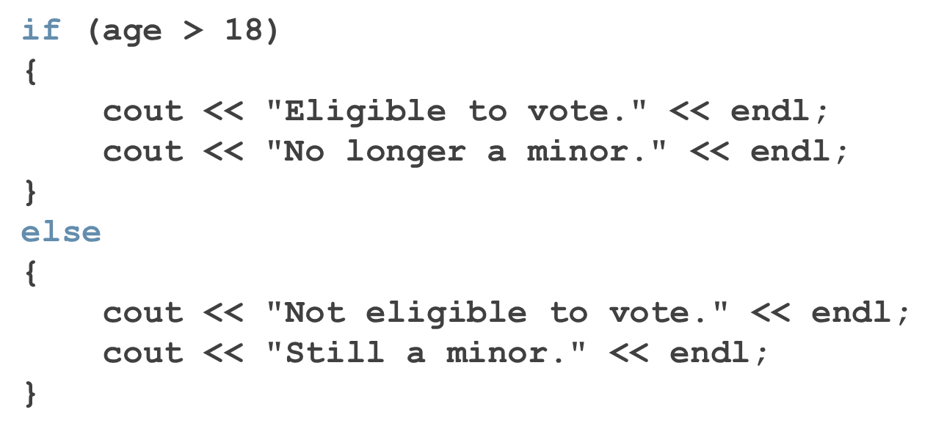
Compound (Block of) Statements

Slide 20
Multiple Selections: Nested if
When one control statement is located within another, it is said to be nested
An else is associated with the most recent if that has not been paired with an else

Slide 21
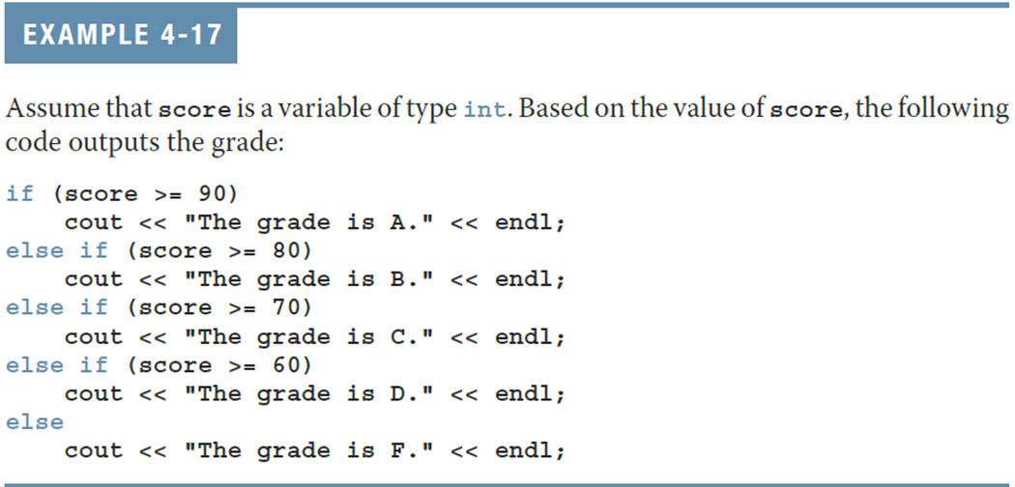
Multiple Selections: Nested if

Slide 22
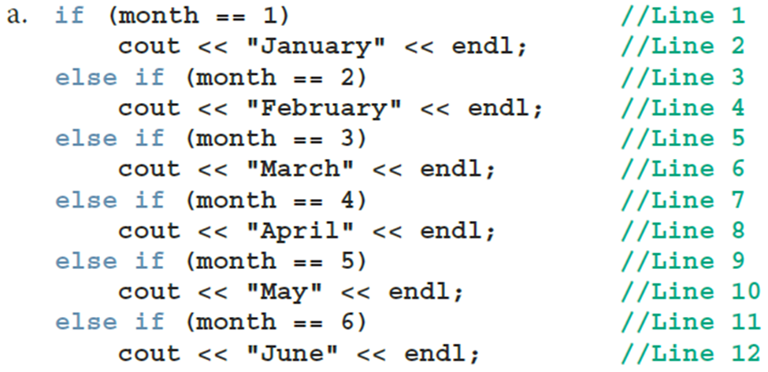
Comparing if…else Statements with a Series of if Statements

Slide 23
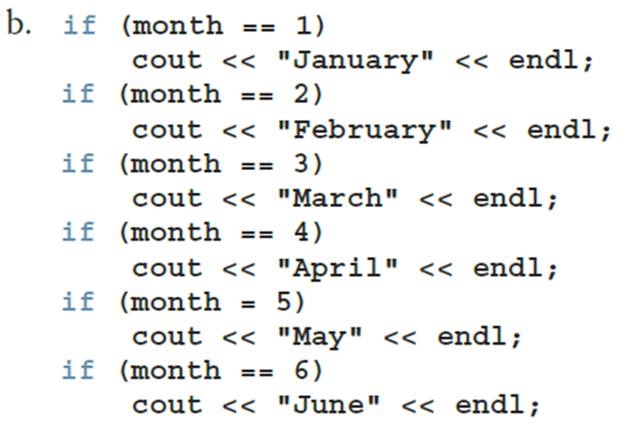
Comparing if…else Statements with a Series of if Statements

Slide 24
Conditional Operator (?:)
Conditional operator (?:)
Ternary operator: takes three arguments
Syntax for the conditional operator
If expression1 is true, the result of the conditional expression is expression2
Otherwise, the result is expression3
Example: max = (a >= b) ? a : b;

Slide 25
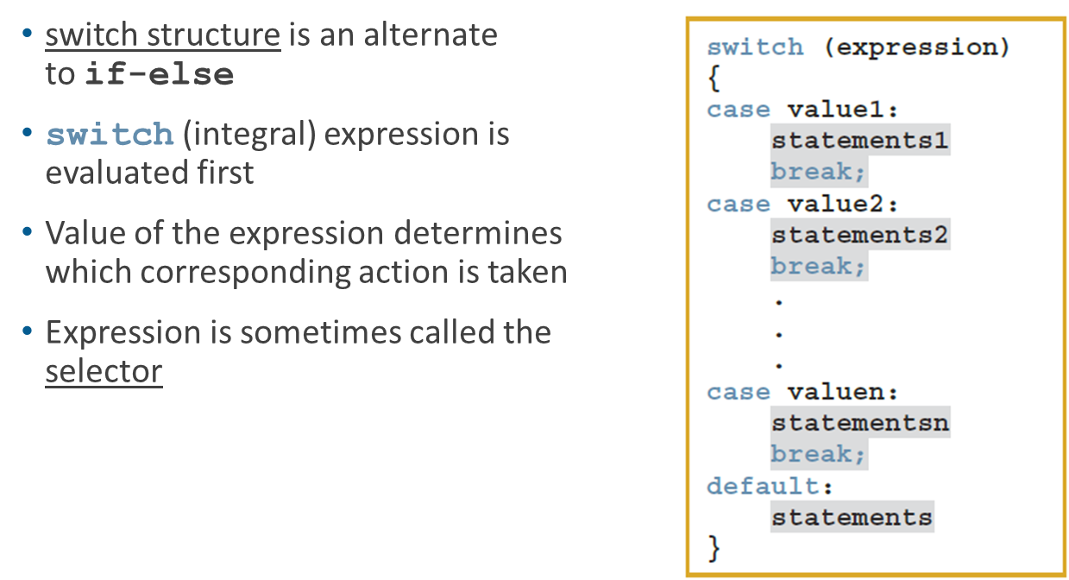
Switch Structures

Slide 26
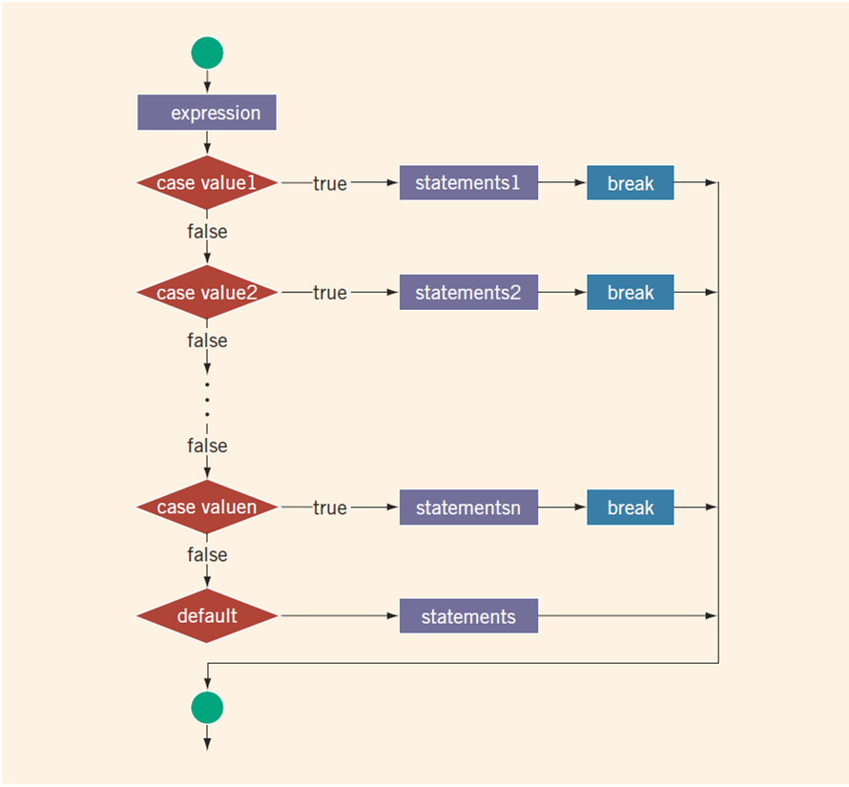
switch Structures

Slide 27
switch Structures
One or more statements may follow a case label
Braces are not needed to turn multiple statements into a single compound statement
When a case value is matched, all statements after it execute until a break is encountered
The break statement may or may not appear after each statement
switch, case, break, and default are reserved words

Slide 28
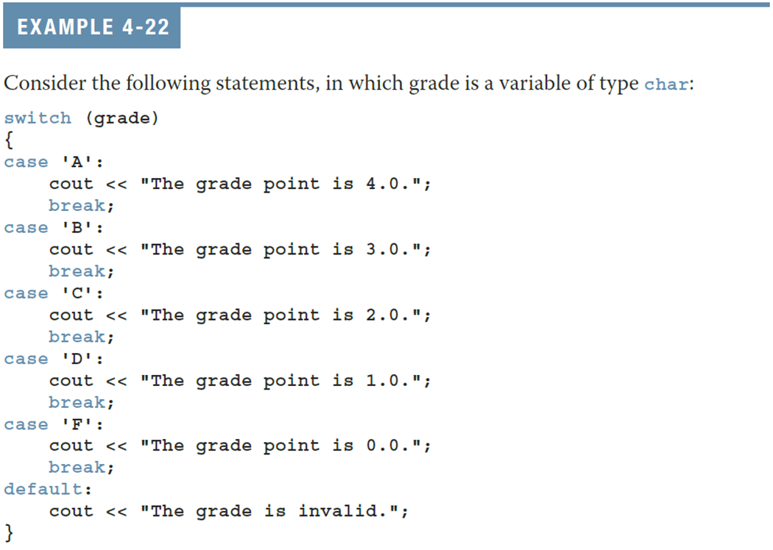
switch Structures

Slide 29
Programming Exercise
Write a program that prompts the user to input a number. The program should then output the number and a message saying whether the number is positive, negative, or zero.

